Slide 1
Samsung Techwin MMC Card SW Plan
Date 2007.3.27
SMT RnD Div2

Slide 2
Contents
1. Summury
2. SW Layer
3. Development Schedule
4. Development & Testing
5. Issues

Slide 3
Summury
[ST Project]
  Processor
    8051 – 100MHz
  Memory Controller
    MMC
    NAND
  Memory
    ROM
    RAM
  Analog IP
    PLL
    OSC
    POR
    VDT

Slide 4
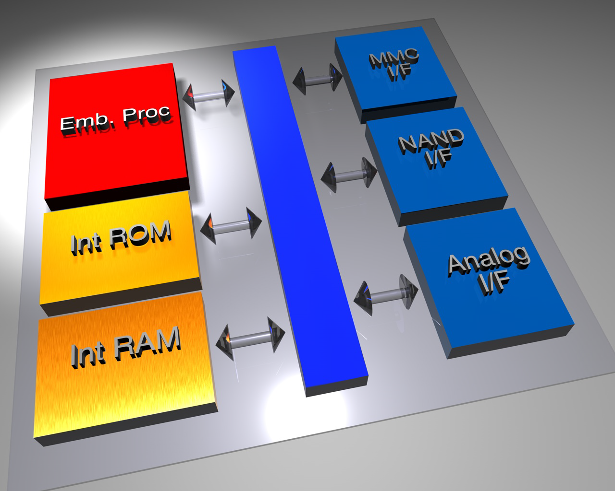
Block diagram

Slide 5
SW Block Diagram
SW Layer
HOST
MMC COMMAND MANAGER
SECTOR MANAGER
CODE MANAGER
MMC MANAGER
NAND MANAGER
NAND Flash

Slide 6
Description
SW Layer
MODULE(MANAGER) | LEVEL | DESCRIPTION
NAND | LEVEL 0 | Support NAND bad block remapping Support NAND access operation per Page (Program/Read/Erase/Reset/etc) Support Multi-plane NAND Support Multiple NAND memory cell Support transaction NAND layer
CODE | LEVEL 0 | Support Download code to NAND (Firmware/MMC information) Support Load code from NAND (Firmware sub module)
SECTOR | LEVEL 1 | Support wearleaving Block erase. (need check) Support transaction Sector layer (Single/Mutiple read/write operation per user size) Support Logical Sector layer for MMC controller Support low level format
MMC | LEVEL 1 | Support MMC Lock/Unlock Support MMC Write protect Group, Erase Group Support MMC security Support MMC information
MMC COMMAND | TOP LEVEL | Support MMC command parsing Support MMC command execute Support module dynamic load/unload Support system init or cleanup

Slide 7
Operation
SW Layer
ROM
NAND
MMC TOP
MMC MANAGER
CODE MANAGER
SECTOR MANAGER OP2
SECTOR MANAGER OP1
SECTOR MANAGER OP0
RAM
NAND MANAGER OP2
NAND MANAGER OP1
NAND MANAGER OP0

Slide 8
MMC Manager I/F
SW Layer
MMC_OCR
MMC
MMC TOP
MMC_CID
MMC_CSD
MMC_ECSD
MMC_IOCtrl
FUNCTION | DESCRIPTION
MMC_OCR | MMC Operation condition register의 내용을 읽고 기록한다.
MMC_CID | MMC Card-Identification register 내용을 읽고 기록한다.
MMC_CSD | MMC Card -Specific Data register 의 내용을 읽고 기록한다.
MMC_IOCtrol | 미정

Slide 9
Sector Manager I/F
SW Layer
ST_Init
SECTOR
MMC TOP
ST_Open
ST_Write
ST_Read
ST_Delete
ST_IOCtrl
ST_Close
ST_Deinit
FUNCTION | DESCRIPTION
ST_Init | SECTOR 모듈을 초기화한다.
ST_Deinit | SECTOR 모듈을 종료한다
ST_Open | Read/Write/Close/Delete/IOCtrl등의 operation session을 연다.
ST_Close | Read/Write/Close/Delete/IOCtrl등의 operation session을 닫는다.
ST_Read | MMC block size 단위로 원하는 sector의 데이터로 read buffer를 채운다.
ST_Write | MMC block size 단위로 원하는 sector에 write buffer의 데이터로 채운다.
ST_Delete | 원하는 sector를 지운다.
ST_IOCtrl | 미정

Slide 10
Code Manager I/F
SW Layer
CODE
MMC TOP
CODE_Load
CODE_Unload
CODE_Write
FUNCTION | DESCRIPTION
CODE_Load | 요구하는 코드를 NAND에서 읽어 들여 RAM에 적재한다.
CODE_Unload | 요구하는 코드를 RAM에서 삭제한다.
CODE_Write | FIRMWARE를 기록할 때 사용한다.

Slide 11
NAND Manager I/F
SW Layer
NAND_Init
NAND
MMC
NAND_Program
NAND_Read
NAND_Erase
SECTOR
NAND_GetInfo
NAND_Deinit
NAND_Remapping
FUNCTION | DESCRIPTION
NAND_Init | NAND controller 초기화 및 NAND bad block table 확인
NAND_Program | MMC block size 단위로 NAND Program
NAND_Read | MMC block size 단위로 NAND Read
NAND_Erase | NAND block 단위로 Erase
NAND_GetInfo | NAND의 정보를 가져온다. (Sector/Page, Page/Block, Device/Block, Plain info)
NAND_Deinit | NAND controller의 해제하고, 현재 섹션의 backup을 만든다.
NAND_Remapping | NAND block 단위로 bad block mapping을 실시한다.

Slide 12
Product Schedule
[Project : 11 months]
Unit: Month
3 | 1 | 2 | 3 | 2
IP Design
FPGA Test
Top Test Sim
FAB Process
M/P Test
FPGA B’D
RTL Freeze
FAB Out
Completed
On-board Test

Slide 13
Development & Testing
FTL
  Out-sourcing / Self-solution
Simulation
  PC-base Functional sim
  SMT Platform-base Functional sim
Board Testing
  MMC Card Platform

Slide 14
Issues
Bad Block Management
Wear-leaving
Debugging Environment
Initial SW Write
Testing NAND Type
Target Performance

Slide 15
End

